Slide 1
The first element of a persuasive essay is a title. It has an introduction, body paragraphs, and a conclusion.

Slide 2
The first element of a persuasive essay is a title. It has an introduction, body paragraphs, and a conclusion.

Slide 3
An introduction is creative, draws attention, communicates the topic in detail and its relevance, asserts author’s opinion, and structures the essay.

Slide 4
HOW?
An introduction is creative, draws attention, communicates the topic in detail and its relevance, asserts author’s opinion, and structures the essay.

Slide 5
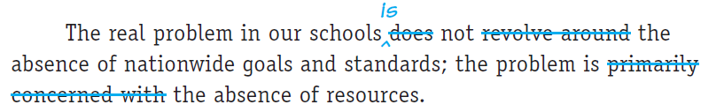
PROBLEM: Vague

Slide 6
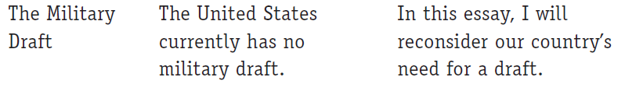
PROBLEM: Personal tone

Slide 7
STRUCTURE
An introduction
Opener
  Current affairs
  Statistic
  Anecdote
  Thought experiment/controversial statement
  Quotation
Thesis statement
  Topic
  Opinion
  Structures paragraphs

Slide 8
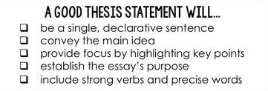

Slide 9
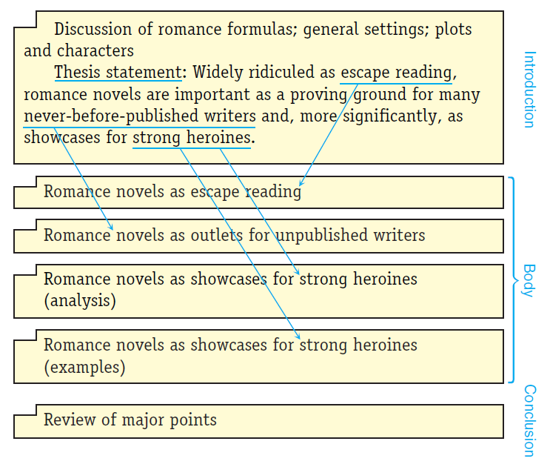
GOOD PRACTICE: Structures paragraphs

Slide 10
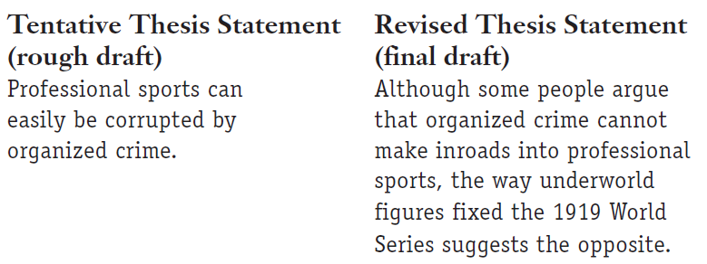
GOOD PRACTICE: Specific

Slide 11
An introduction is creative, draws attention, communicates the topic in detail and its relevance, asserts author’s opinion, and structures the essay.

Slide 12
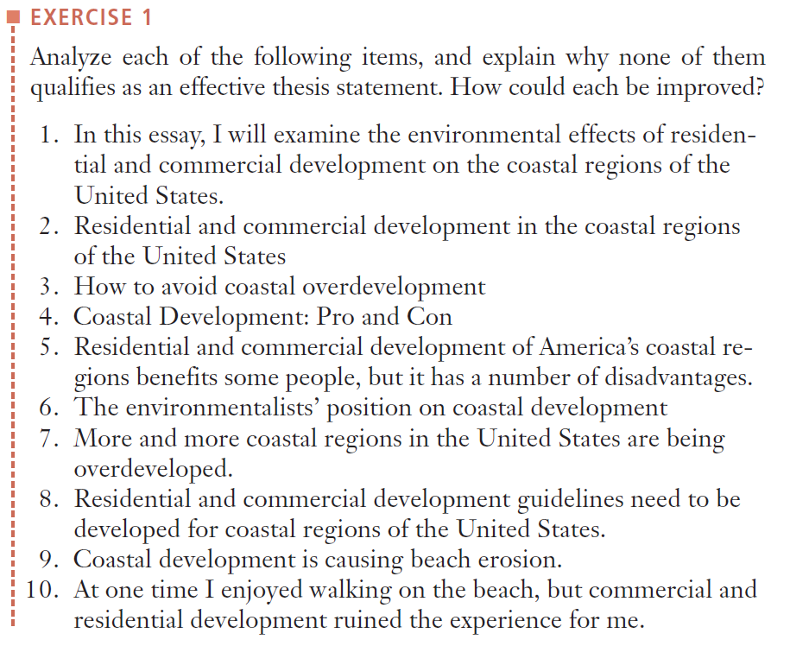

Slide 13
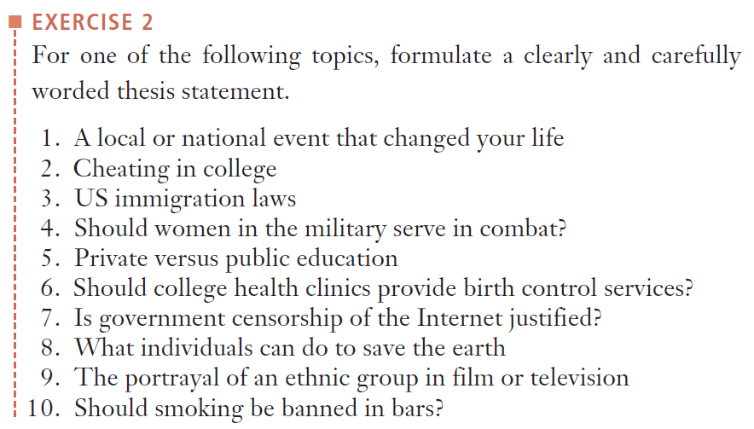

Slide 14
Body paragraphs are unified, coherent, and well-developed.

Slide 15
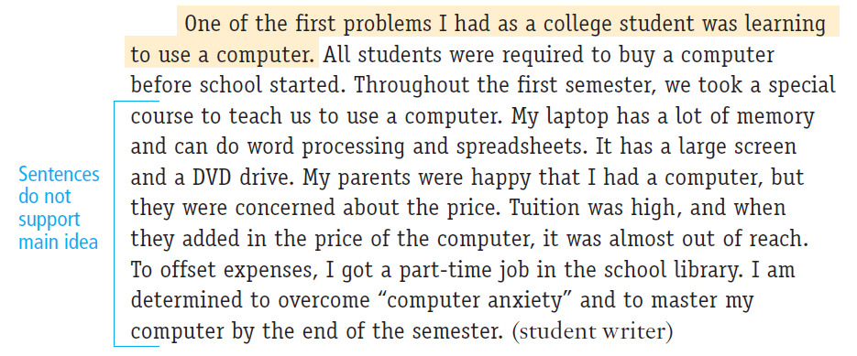
PROBLEM: Not unified

Slide 16
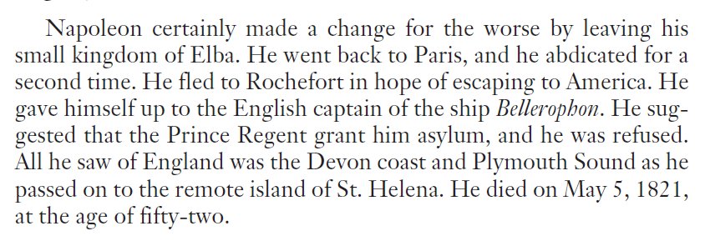
PROBLEM: Incoherent

Slide 17
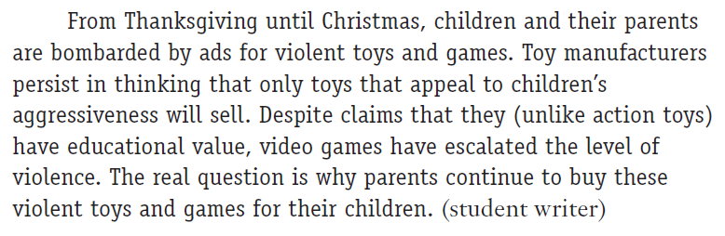
PROBLEM: Underdeveloped

Slide 18
Body paragraphs are unified, coherent, and well-developed.
HOW?

Slide 19
STRUCTURE
Body paragraph
Transition word(s)
Topic sentence (beginning or end)
Support
  Reasoning
  Examples
  Statistics
  Expert opinion
  Anecdotal evidence

Slide 20
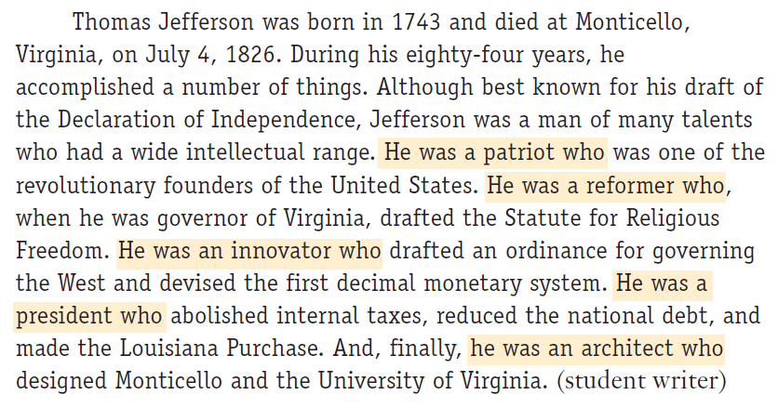
GOOD PRACTICE: Unified

Slide 21
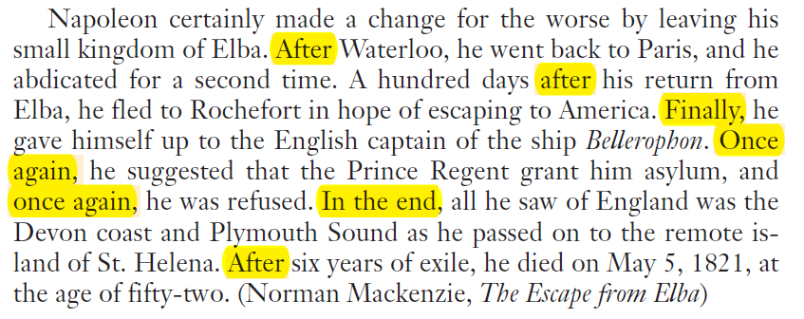
GOOD PRACTICE: Coherent

Slide 22
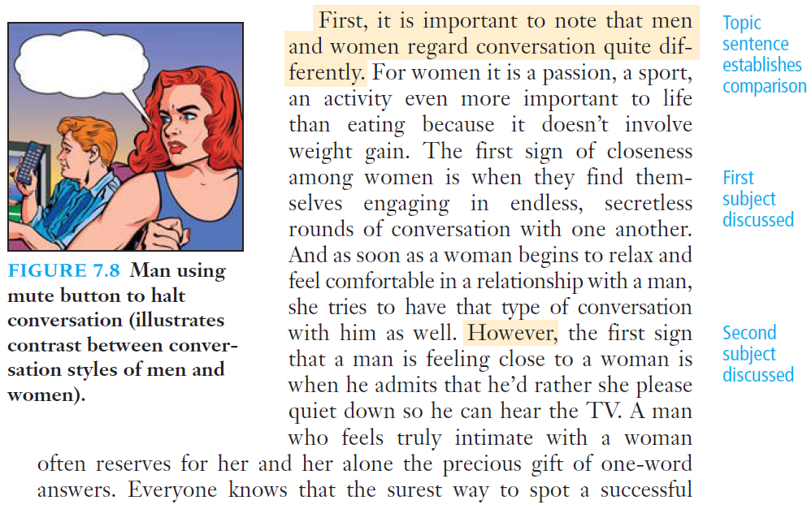
GOOD PRACTICE: Coherent

Slide 23
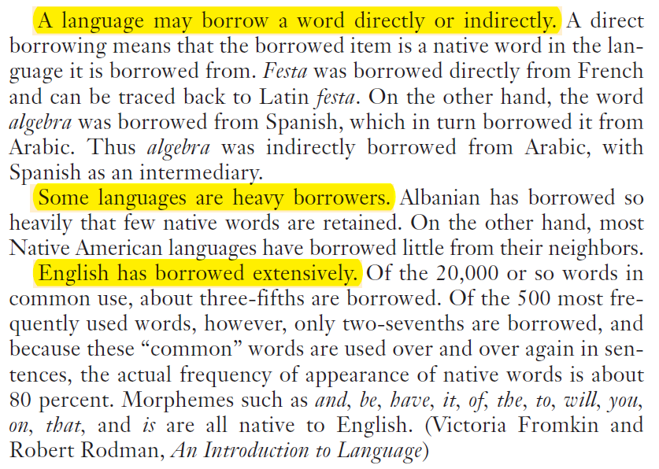
GOOD PRACTICE: Coherent

Slide 24
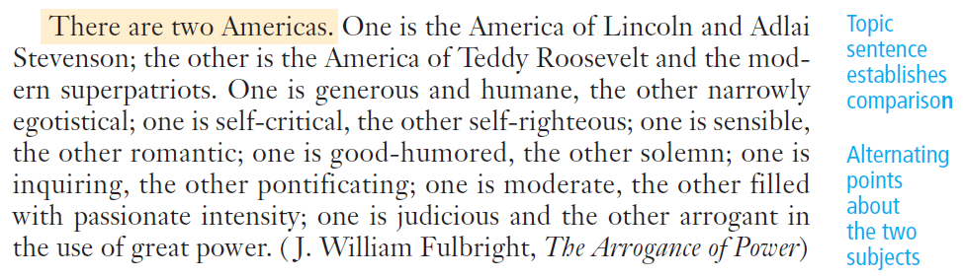
GOOD PRACTICE: Topic sentence

Slide 25
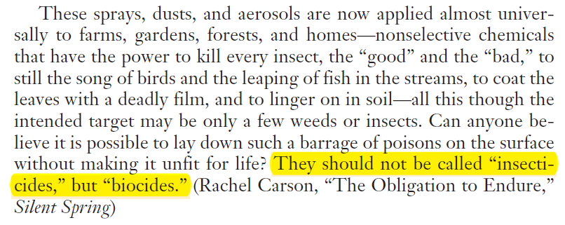
GOOD PRACTICE: Topic sentence

Slide 26
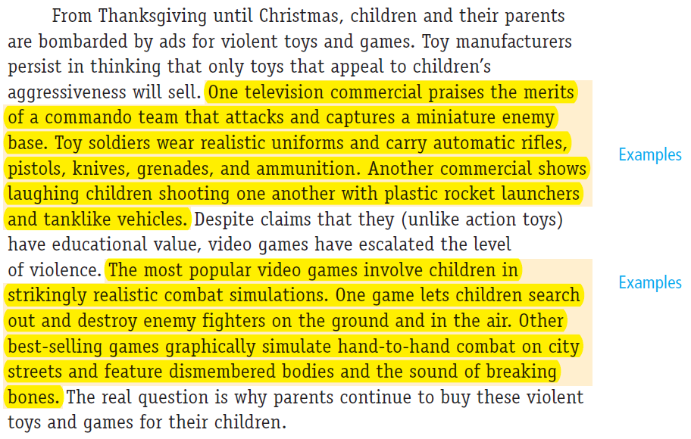
GOOD PRACTICE: Well-developed

Slide 27
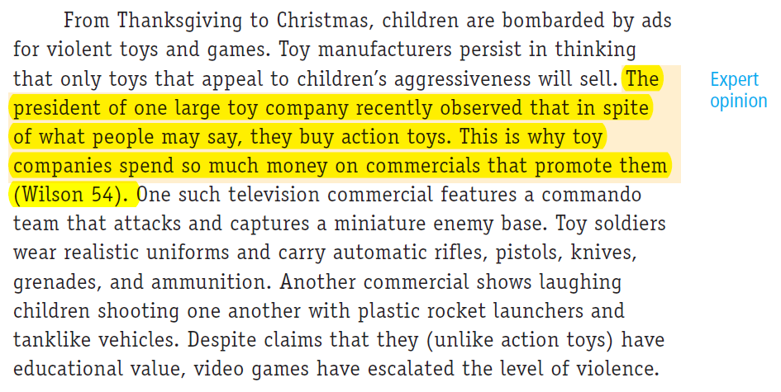
GOOD PRACTICE: Well-developed

Slide 28
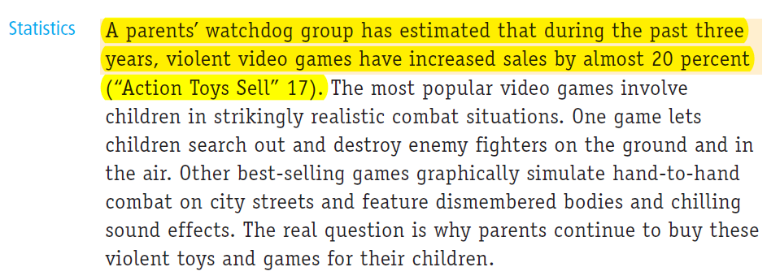
GOOD PRACTICE: Well-developed

Slide 29
Body paragraphs are unified, coherent, and well-developed.

Slide 30
A conclusion generalises and is poignant.

Slide 31
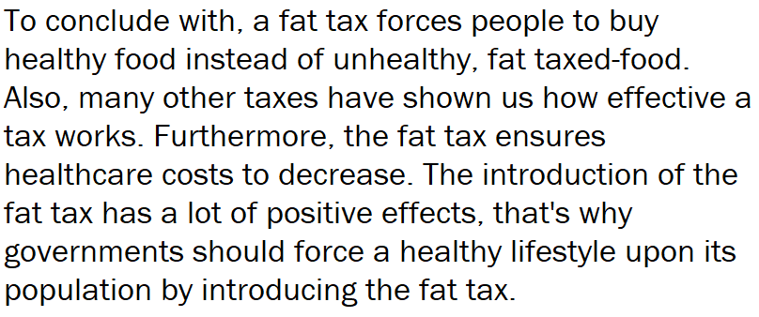
PROBLEM: Summary

Slide 32
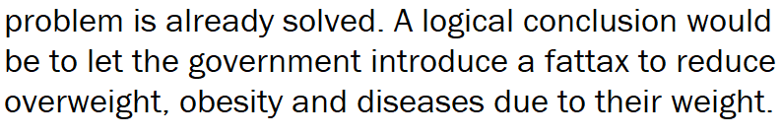
PROBLEM: Weak
(final sentence of a student essay)

Slide 33
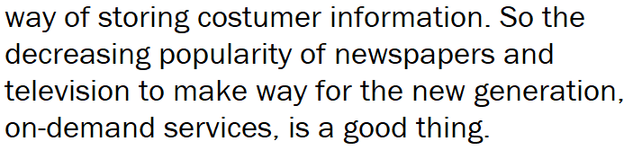
PROBLEM: Weak
(final sentence of a student essay)

Slide 34
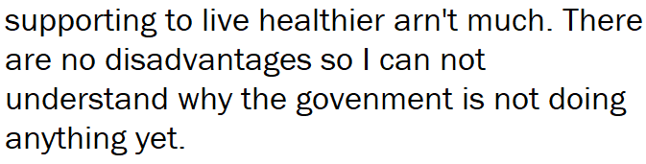
PROBLEM: Weak
(final sentence of a student essay)

Slide 35
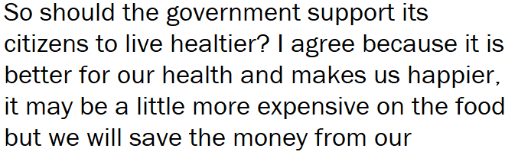
PROBLEM: Personal
(conclusion of a student essay)

Slide 36
A conclusion generalises and is poignant.
HOW?

Slide 37
STRUCTURE
A conclusion
Condenses specifics into general statement
Content
  Prediction
  Warning
  Recommendation
  Quote
Memorable final sentence

Slide 38
GOOD PRACTICE: Loop back phrase/idea

Slide 39
GOOD PRACTICE: Link to old/new context

Slide 40
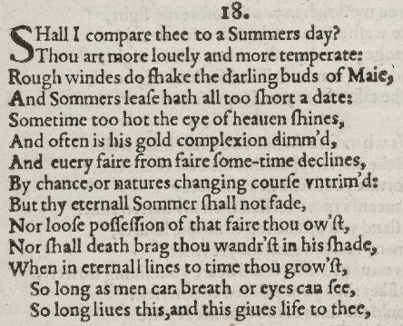
GOOD PRACTICE: One syllable words/short sentences

Slide 41
A conclusion generalises and is poignant.

