Slide 1
English renaissance period
1485 - 1603

Slide 2
1485 - 1603
1485 landmark, decisive point in history:
Start of House of Tudor (house = dynastic family) when Henry VII became king.
-> Ended War of the Roses when Henry Tudor (House of Lancaster) married Elizabeth (House of York)
-> Marked the start of a period of relative stability
1603 Elizabeth I died (James I became king)
Notes:
Name ‘War of the Roses’ because both the House of Lancaster (Red) and the House of York (white) had roses as symbols in their coat of arms. A dynasty is a royal family

Slide 3
renaissance
Renaissance ‘rebirth’: the revival of European art and literature under the influence of classical models in the 14th–16th centuries
14th century Renaissance started in Italy. Italy's early start can be attributed to its rich history, artistic heritage, and influential city-states.
15th century Renaissance ideas spread from Italy to France and then throughout western and Northern Europe
Notes:
Revival of classical knowledge
Later than in Italy because of the Black Death and Italy’s trade monopolies, which slowed down economic growth in the North. Feudalism was much more present in European society outside of Italy which caused the ideas of the Renaissance to spread slowly. Feudalism was a system of social, economic, and political organization that prevailed in Europe during the Middle Ages. It was based on the relationship between lords and vassals, who exchanged land for loyalty and service. This was because Feudal society was not as open to new ideas as the city-states that existed in Italy at the time.

Slide 4
renaissance
16th century Though 1485 is taken as its starting point, the Renaissance mainly spread through England during the reign of Queen Elizabeth (The Elizabethan Age 1558 – 1603).
This was a time of political stability, which came with a sense of national identity, patriotism and cultural pride.
Feudalism had slowed down the spread of Renaissance ideas. England's Renaissance was delayed until the emergence of more favourable conditions for art, scholarship, and intellectual growth.
Notes:
The Renaissance, a cultural and intellectual movement that spanned roughly from the 14th to the 17th century, did indeed begin in Italy and reached England at a later time. Several factors, including nationalism, patriotism, stability, and economic considerations, help explain this timing discrepancy:
Italian Renaissance Pioneering: Italy was the birthplace of the Renaissance due to its unique historical, cultural, and economic circumstances. Cities like Florence, Venice, and Rome were centers of art, trade, and scholarship, fostering an environment conducive to the flourishing of the Renaissance. Italy's early start can be attributed to its rich history, artistic heritage, and influential city-states.
Nationalism and Patriotism: Nationalism and patriotism play a role in shaping a country's cultural movements. During the Italian Renaissance, a sense of civic pride and patriotism in various city-states motivated patrons to support the arts and sciences. In England, it took some time for a similar sense of national identity and cultural pride to emerge, delaying the Renaissance. After defeating the Spanish Armada in 1588, the English people became more patriotic and nationalistic.
Stability: Political stability and the presence of strong central authority can significantly impact cultural movements. Italy's city-states had relative stability during the Renaissance, allowing for the patronage and growth of the arts and sciences. In contrast, England faced periods of political turbulence, including the Wars of the Roses, which hindered cultural development.
Economic Factors: Economic prosperity and patronage are essential for the support of artists, scholars, and cultural endeavors. The Italian city-states had a thriving economy, fueled by trade and commerce, which facilitated the sponsorship of artists and intellectuals. England's economy was less urbanized and had a different economic structure during the early stages of the Renaissance, which contributed to the delay.
In summary, the Renaissance started later in England compared to Italy due to a combination of historical, cultural, and economic factors. Italy's early Renaissance was characterized by its unique historical legacy and the presence of prosperous city-states that provided the necessary conditions for cultural flourishing. England's Renaissance was delayed until the emergence of more favorable conditions for art, scholarship, and intellectual growth.

Slide 5
renaissance
Characteristics of the English Renaissance:
Individualism
Intellectual rebirth
Freedom of thought and action
Thirst for knowledge
Scientific outlook
Humanism
Love for beauty and adventure
The desire for unlimited power and wealth

Slide 6
assignments
Did you manage to find all the answers to the questions in assignment 1?

Slide 7
Protestant reformation
The Protestant Reformation, led by Martin Luther in 1517, challenged the Roman Catholic Church's practices and doctrine.
It emphasized faith and the Bible as supreme authorities.
This movement significantly impacted religion, culture, and politics, shaping modern Western society.
Notes:
Luther's objections to the Catholic Church's teachings and practices centered on issues such as the sale of indulgences (payments for the forgiveness of sins – remember the Pardoner’s Tale?), the authority of the Pope (they believe no human is fallible), and the use of Latin in religious services, which made them inaccessible to many common people. He believed in the importance of faith, the Bible, and the concept of "justification by faith alone."

Slide 8
humanism
Humanism is a human-centered philosophy that values individual freedom, dignity, and potential.
It is optimistic about human capabilities. It relies on reason and evidence to understand the world and shape one’s own life, marking a shift away from medieval theology. Not God, but humans became the centre of attention.
It created an environment in which scholars and thinkers made new discoveries in a wide range of fields, e.g. Galileo Galilei and Columbus
Erasmus (1466 – 1536) was a Dutch Renaissance humanist, scholar, and theologian. Erasmus's writings and ideas had a significant influence on the intellectual and religious climate of his time.
Notes:
Humanism is a philosophical and intellectual movement that emerged during the Renaissance in Europe, notably in the 14th and 15th centuries. It prioritizes the study of classical literature, art, and the humanities, emphasizing human potential, reason, and individualism. Humanists advocate for a well-rounded education, valuing critical thinking, ethics, and the development of human creativity. This intellectual shift played a pivotal role in breaking away from the dominance of medieval theology and the Church, fostering a revival of interest in classical knowledge and leading to advancements in art, literature, and science. Humanism had a lasting impact on Western culture and the Enlightenment.
In summary, Galileo Galilei became famous for his groundbreaking astronomical discoveries and support for the heliocentric model (sun at the centre of the solar system), while Christopher Columbus is famous for his exploration of the Americas, which had a profound and lasting impact on global history.

Slide 9
assignments
Did you manage to find all the answers to the questions in assignment 2?

Slide 10
British history: Henry VIII (1491 – 1547)
1509 Henry VIII took the throne and married Catherine of Aragon
Catherine was Henry’s late brother’s wife. He had to marry her to seal a marital alliance between Spain and England.
In order to make this possible they needed papal dispensation, otherwise it was considered incest.
They had one daughter: Mary
That was a big disappointment for Henry, who wanted a son to succeed him.
1533 Henry married Anne Boleyn
The Pope wouldn’t grant him and Catherine a divorce so Henry VIII broke with the Roman Catholic Church and started his own church. He had Parliament declare him supreme head of the Church of England/ Anglican Church. > English Reformation
They had one daughter: Elizabeth
Notes:
Henry got married when he was only 18, to Catherine, who was 24 at the time. Catherine had been engaged to Henry’s brother Arthur since she was 3. When Henry had theur marriage declared invalid they had been married for 24 years. The people’s sympathy was with her.

Slide 11
Question
What is Homo Universalis?
What does this person have to do with the ideals of the Renaissance?
Let’s have a look at assignment 4

Slide 12
Henry VIII (1491 – 1547)
1536 Henry had Anne executed and married Jane Seymour
They had one son: Edward VI.
Henry declared both of his daughters illegitimate so Edward
could succeed him.
1540 Henry married Anne of Cleves after Jane died giving birth to Edward.
1540 Henry had the marriage to Anne annulled and married Catherine Howard
1543 Henry had Catherine beheaded for adultery and married Catherine Parr
https://youtu.be/rTdTDCRKvvM

Slide 13
Religious quarrels
1547 After Henry died, Edward VI became king (he was 9).
During his reign Protestantism was established and the Catholic doctrine renunciated (=opgegeven).
1553 After Edward died of tuberculosis, his half-sister Mary I (Bloody Mary) claimed the throne. She was a devout Catholic who married Philip of Spain.
1558 When Mary I died, she was succeeded by her half-sister Elizabeth I, who again established the Protestant Church (Church of England). Elizabeth I never married and is known as The Virgin Queen.
Notes:
Mary is best known for her vigorous attempt to reverse the English Reformation, which had begun during the reign of her father, King Henry VIII. Protestants faced a choice: exile, reconciliation/conversion, or punishment. Many people were exiled, and hundreds of dissenters were burned at the stake, earning her the nickname of "Bloody Mary”

Slide 14
The elizabethan age
1588 England beat the Spanish Armada of King Philip II
Elizabeth reigned for 44 years and this period provided stability for the kingdom and helped forge a sense of national identity.
Literature: English drama flourished and people were proud of their language
England was doing well both economically and culturally.
1603 Elizabeth died and was succeeded by James I

Slide 15
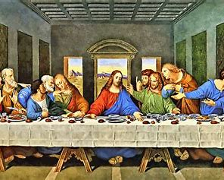
Renaissance art
Notes:
- The Last Supper by Leonardo da Vinci (1495–1498). Leonardo’s Last Supper is one of the best examples from the Renaissance of a painter incorporating the tools of linear perspective to create a highly rendered illusion of deep space on a two-dimensional surface.
- David by Michelangelo (1501–1504). Michelangelo’s sculpture of the Biblical David is one of the most monumental sculptures ever carved from a single block of marble.
-Organizers of the Paris Olympics have apologized for what some critics described as a parody of “The Last Supper” during the lavish opening ceremony on Friday.
The scene featured drag artists and dancers and was widely criticized by the Catholic church and Christian groups. Thomas Jolly, the director of the opening ceremony, insisted that “The Last Supper” – a mural painted by Renaissance artist Leonardo da Vinci – wasn’t the inspiration behind the scene in an interview with CNN affiliate BFMTV on Sunday.
“Dionysus arrives at the table because he is the Greek God of celebration and that sequence is called ‘festivity,’” Jolly said.

Slide 16
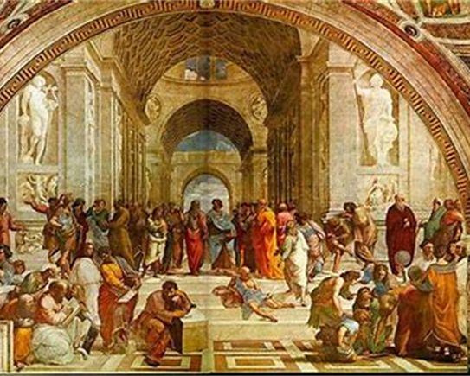
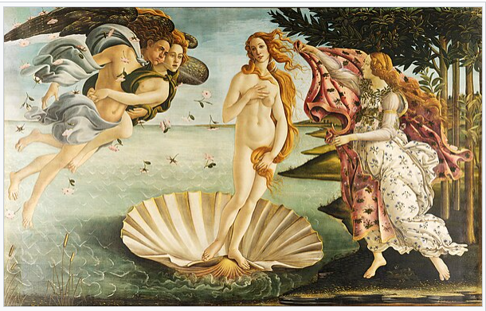
Renaissance art
Notes:
- -The School of Athens by Raphael (1509–1511): The School of Athens depicts all of the great Greek philosophers debating in the topics that are most associated with humanism and ancient philosophy, and highlights the philosophical and educational values of the Renaissance period.
- The Birth of Venus by Sandro Botticelli (1485–1486). The Birth of Venus is one of the most famous paintings of a female nude from the Renaissance period. The image depicts the ideals of feminine beauty during the fifteenth century in Italy while also telling the story of an ancient mythological goddess.

Slide 17
Renaissance architecture
Notes:
Renaissance architecture used many classical elements, including domes, columns, pilasters (rectangular columns), lintels (a type of beam), arches, and pediments (triangular gables) in an orderly and repetitive fashion.
St Peter’s Basilica in the Vatican with the Sistine chapel

Slide 18
homework
Finish assignments 5a and 5b

Slide 19
Literature in the elizabethan age
Poetry and drama (theatre) blossomed under Elizabeth’s reign.
Elizabeth's specific actions, her image, and the court atmosphere she nurtured significantly influenced—even inspired - great works of literature.
Drama: e.g. playwrights Christopher Marlowe, Shakespeare
Poetry:
Lyric poetry (expressing personal emotions): sonnets, e.g. Spenser
Epic poetry (narrative, telling a story): Milton’s Paradise Lost
Notes:
Action: she invited theatre companies to perform at her palaces, which helped their reputations (they were considered immoral by the Puritans)
Image: she was THE symbol of the day
Paradise Lost: The poem concerns the biblical story of the fall of man: the temptation of Adam and Eve by the fallen angel Satan and their expulsion from the Garden of Eden.

Slide 20
The sonnet
Sir Thomas Wyatt (esquire, later diplomat) introduced the sonnet in England
1 First, he translated the Italian poet Petrarch (Petrarca)
2 Then, he started to write his own sonnets
Sonnet: ‘little song’, lyric (= about feelings)

Slide 21
Italian and english sonnets
Italian (Petrarcan) English (Shakespearean)
14 lines 14 lines
2 x 4 3 x 4
Break of Thought Break of Thought
2 x 3 1 x 2
Abba abba cde cde/ cdc cdc abab cdcd efef gg
Both are iambic pentameters (IP): each line has 10 (5 x 2) syllables, alternately unaccented and accented
One day I wrote her name upon the strand

Slide 22
question
What is an iambic pentameter?
If you want to make a quick check whether a sonnet is English or Italian, what do you look at?
What did Queen Elizabeth do that had a positive influence on the popularity of theatre?

Slide 23
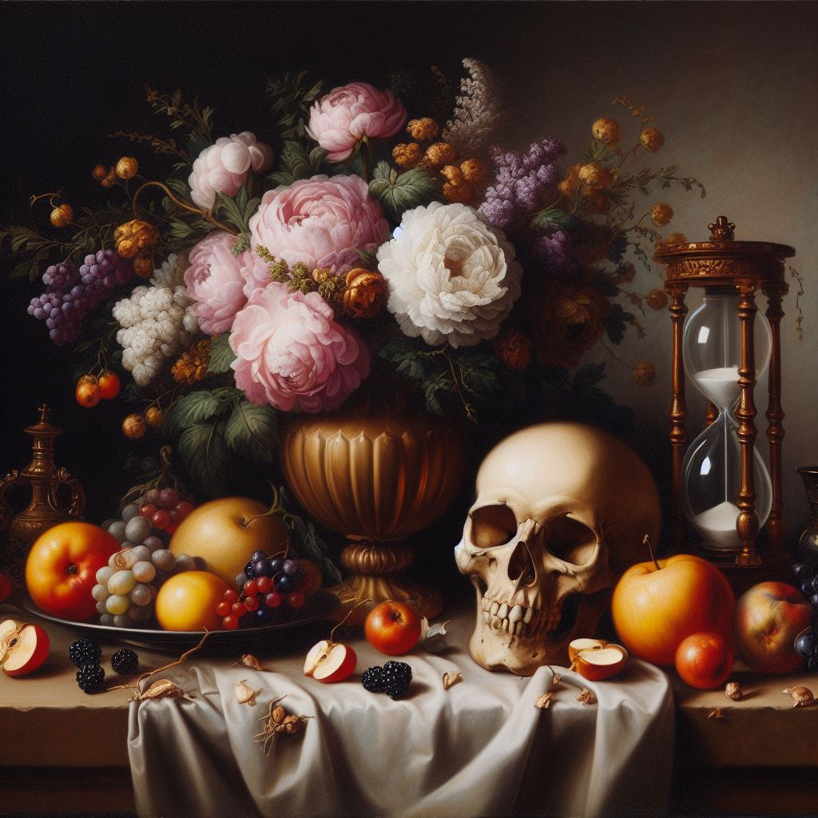
Vanitas (Sonnet 75 spenser)
Vanitas = pointlessness, or futility, is a genre of memento mori symbolizing the transience of life and the certainty of death, and thus the vanity of ambition and all worldly desires.

Slide 24
Shakespeare’s globe theatre
Notes:
Differences= theatre is not highbrow, looked down upon / no artificial light (so daytime) / you could see the actors and they could see you

Slide 25
Shakespeare’s tragedies
Tragedies are about fate, or about fatal flaws of the characters.
In Shakespeare’s days, plays were divided into 5 acts, just like in ancient Greece. (remember: renaissance..)
Each act consisted of one or more scenes.
The first act, the prologue, introduced the characters, the setting and some important facts.
Find a summary of Romeo and Juliet (1597) here:
https://youtu.be/dRrvQ1vZxcg
https://www.sparknotes.com/shakespeare/romeojuliet/summary/

Slide 26
Imagery in Romeo & Juliet
Romeo uses a lot of celestial imagery = hemelse beeldspraak
- from ACT 2, scene 2: sun, moon, stars, heaven, angel, winged messenger
Juliets uses more earthly imagery: Montague is not a hand, foot, etc. ; she uses the metaphore of the rose. She uses far less imagery than Romeo.
→ Juliet is more practical, with both feet on the ground. She keeps reminding Romeo of practical things, like the danger of being seen or how and when to meet again.

Slide 27
Shakespeare’s tragedies
Hamlet (1602) is one of Shakespeare’s best and most famous tragedies.
It is a story about revenge with a tragic hero who is indecisive.
Find a summary of Hamlet here:
https://youtu.be/t0CqUTmwKiM
Or here: https://www.cliffsnotes.com/literature/h/hamlet/play-summary
For a translation and analysis of the ‘to be or not to be’-soliloquy, go to:
https://nl.wikipedia.org/wiki/To_be,_or_not_to_be
And watch Kenneth Branagh here: https://youtu.be/SjuZq-8PUw0

Slide 28
Metaphysical poetry
17th century Metaphysical poetry was very different from the sonnets.
Sonnets Metaphysical poetry
Focus on form/ artificial free form/ rhythm of spoken language
Had to sound beautiful natural, not necessarily beautiful
(busy old fool, unruly sun!)
Fluent energetic, surprising, irregular
Thought/ content often cliche thought had to be original
> focus on form > focus on content

Slide 29
Metaphysical poetry
Characteristics:
Combination of thought and emotion (‘A thought to me is as immediate as the odour of a rose’)
Highly intellectualized, containing complicated thought
Unexpected beginnings to attract attention
Scientific jargon mixed with everyday language
Rhythm of spoken language (punctuation!)
Use of conceits: far-fetched comparison, often involving science
Argumentative

